Slide 1
Fake Review Detection Using NLP
Supervised binary classification • Natural Language Processing
Problem & objective
Dataset at a glance
Identify potentially fake product reviews by analysing review text and related details, helping customers make more informed purchasing decisions.
40,526 records • 4 columns
Input features listed: Text, Category and Rating.
The supplied slide does not state the exact target-column name or numeric label mapping.
Methodology
Algorithms compared
Data collection → text preprocessing → TF-IDF feature extraction → feature encoding → 80:20 train-test split → model training → evaluation → new review prediction.
Logistic Regression • Multinomial Naive Bayes • Linear SVC • SGD Classifier • Decision Tree
LEARNING TYPE
TASK
BEST REPORTED MODEL
Supervised
Binary classification
Linear SVC
Learns from labelled examples
Fake / Genuine
90.71% test accuracy
Target classes: Fake and Genuine. Confirm the dataset’s actual 0/1 encoding before stating which number represents each class.

Slide 2
Fake Review Detection | Model Comparison
Five classifiers evaluated on the test set
Classifier | Accuracy | Precision | Recall | F1-score
Linear SVC | 90.71% | 90.71% | 90.71% | 90.71%
Logistic Regression | 89.85% | 89.86% | 89.85% | 89.85%
Multinomial Naive Bayes | 88.26% | 88.26% | 88.26% | 88.26%
SGD Classifier | 87.63% | 88.35% | 87.63% | 87.57%
Decision Tree | 72.95% | 74.04% | 72.95% | 72.64%
BEST CLASSIFIER
TEST ACCURACY
TEST RECORDS
Linear SVC
90.71%
8,106
Highest test accuracy
7,353 / 8,106 correct
20% test split
Linear SVC achieved the highest reported accuracy among the five compared algorithms.

Slide 3
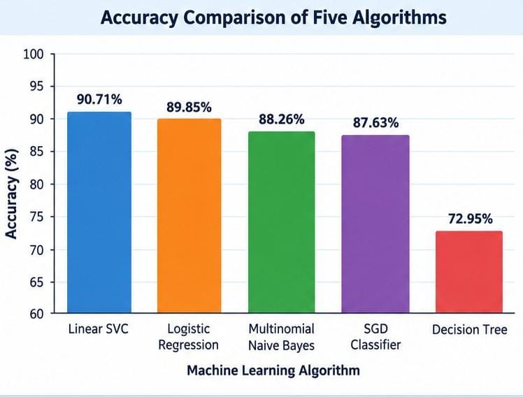
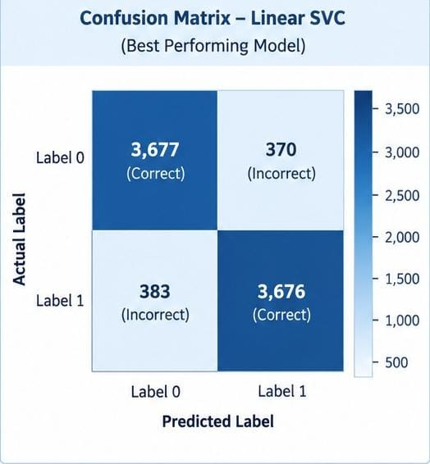
Fake Review Detection | Evaluation & Conclusion
Accuracy comparison and confusion matrix for Linear SVC
Accuracy comparison
Confusion matrix – Linear SVC
Metrics used: accuracy, precision, recall, F1-score and confusion matrix. Linear SVC achieved 90.71% test accuracy and was selected as the best-performing classifier in the reported comparison.

